Slide 1
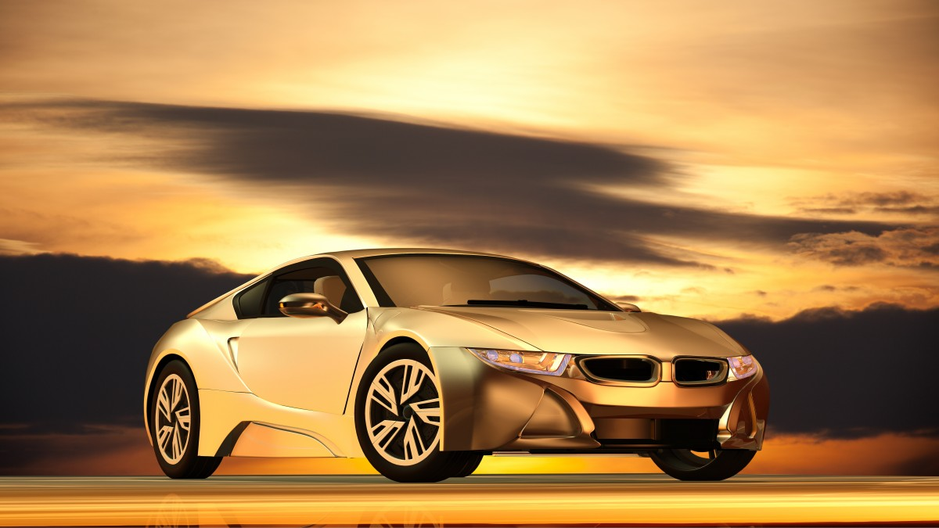
Pre owned Cars Price Prediction
PRE-OWNED CARS PRICE PREDICTION

Slide 2
Business Problem Framing
COVID19 has brought a major impact, this has changed lot in the market. Some cars are in demand, hence its making them costly and some are not in demand they are becoming cheaper.
With the major change in market, clients are facing problems with the old data available. So to derive new data, I have used Web scraping for scarping the details.
I have developed a model which will be highly effective. Regression Algorithms are used because they provide us with continuous value as an output and not a categorized value. Because of which it will be possible to predict the actual price of a car rather than the price range of a car.
User Interface has also been developed which acquires input from any user and displays the Price of a car according to the data provided by the user.

Slide 3
Objectives of the Study
Analyze and forecast the size of India used car market.
Categorize the market on the basis of vehicle type, sector, sales channel, fuel type and regional distribution.
Identify major drivers, challenges and trends of India used car market.
Scrape the pre-owned cars data from different websites.
Conduct the pricing analysis for India used car market.
Identify and analyze the profile of leading players operating in India used car market.
Build a supervised machine learning model for forecasting value of a vehicle based on multiple attributes.
The system that is being built must be feature based i.e. feature wise prediction must be possible.
Providing graphical comparisons to provide a better view.

Slide 4
Motivation for the Problem Undertaken
India’s used car market is projected to reach over $ 66 billion by 2022, as the population is growing in the country.
Increasing focus of automakers towards setting up used car networks in different parts of the country and growing inclination of consumers towards used cars owing to their affordability and improved after sales services are some of the other major factors expected to boost demand for used cars in India in the coming years.
Moreover, market growth is anticipated to be driven by rising penetration of online platforms such as OLX, Car Dekho, Cars24 etc., that enable used car dealers to boost their reach to a larger audience. So, as it is on growing business, I want to predict the used car prices and give correct information for the people in order to sell or buy a used car from which we can save huge bugs. Based on existing data, the aim is to use machine learning algorithms to develop models for predicting used car prices.

Slide 5
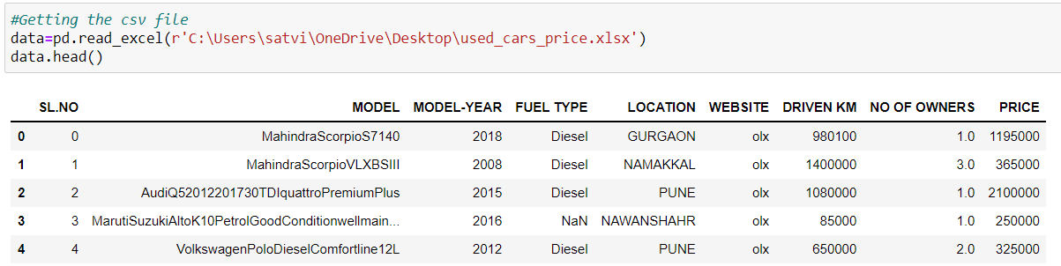
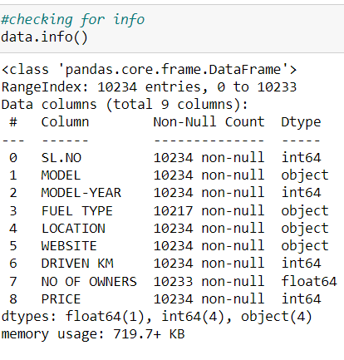
Data Sources and their formats
The source I have used is web scraping selenium for collecting the pre-owned cars data from different websites.
I have used different websites OLX, CARDEKHO, CARS24 to scrape the details.
From the websites I have collected the data which are car model, model year, driven kilometres, location, price, fuel type, etc. and saved in excel file.
Then by using pandas I have imported the excel file.

Slide 6
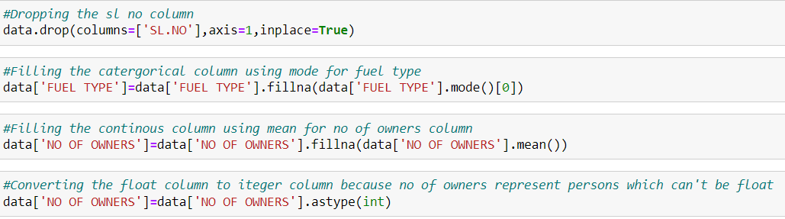
Data Pre-processing Done
There are few null values present in the dataset by using some of the imputing techniques, we need to fill the NaN values using mean or mode method on the type of the data in the columns. For the categorical variables I have use mode method to fill and for continuous columns I used mean to fill the NaN’s.

Slide 7
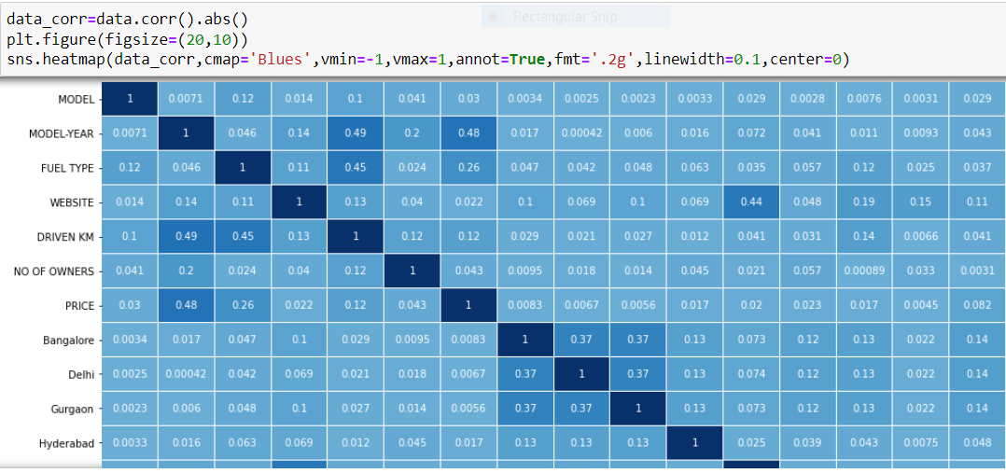
Data Inputs- Logic- Output Relationships
1.The Dark blue indicates high correlation and light blue indicates less correlation.
2.Our label is highly correlated with model-year, and very less correlated with other cities
3.Even some of the features are correlated with the other features like driven km is correlated with model year, website is correlated with Jaipur, etc.

Slide 8
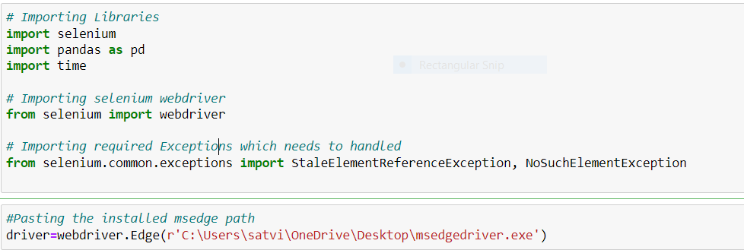
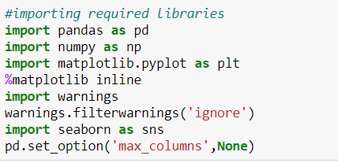
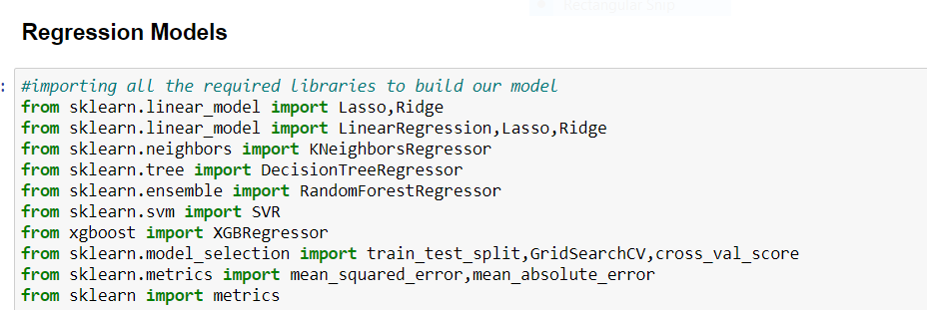
Hardware and Software Requirements and Tools Used

Slide 9
Model/s Development and Evaluation
I have plotted box plots to check for outliers and distribution plots to check the skewness so I found the presence of outliers and skewness in the continuous data. So, I have used Z-Score method for removing the outliers and log transformation method the remove the skewness.
I have used standard Scaler to scale the data.
I have imported the train-test-split from the module sklearn from model selection. And used 75% of the data for training and 25% of the data for testing and splitted the data into x-train, x-test, y-train, y-test.
The price of the used cars prediction is a numerical variable so it comes under regression problem, So I have used 8 different algorithms to check the model patterns. In order to final a model we have to check on different evaluation metrics like finding the score of the training data and testing data and finding the errors like mean absolute error (MAE), mean squared error (MSE) and Root mean squared error (RMSE). In order to tell a model is good their RMSE value should be as less as possible then we can say the model is efficiently working on the given data.

Slide 10
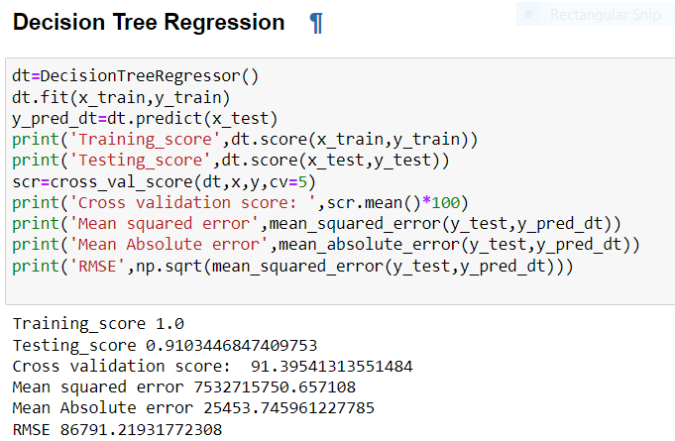
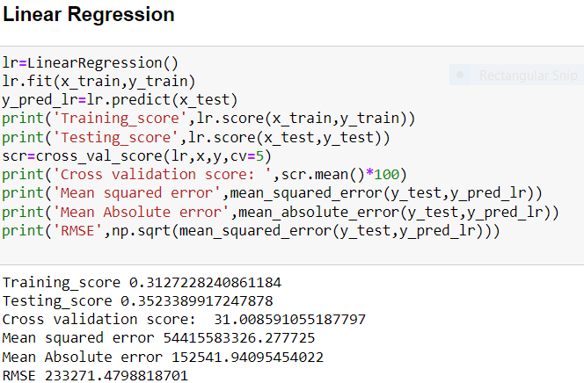
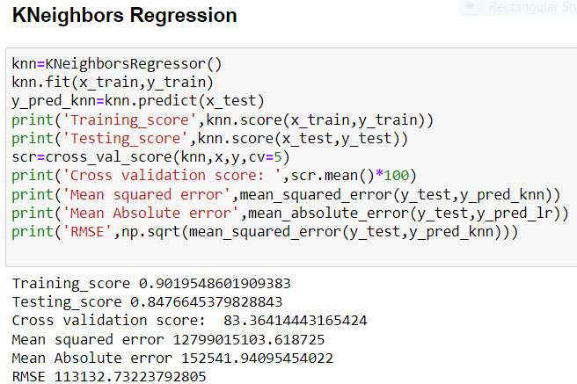
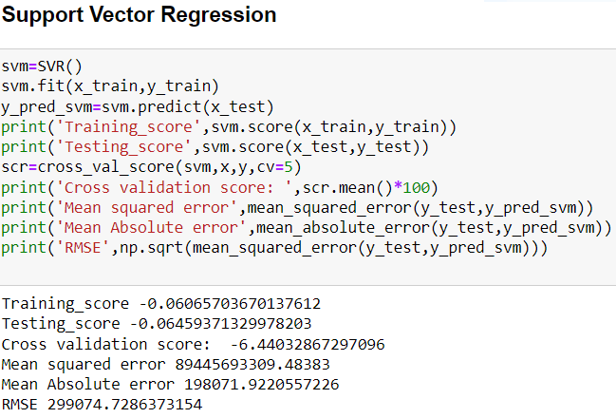
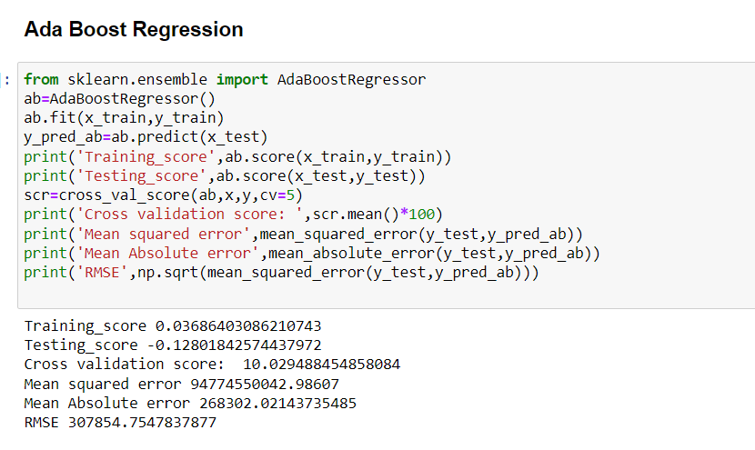
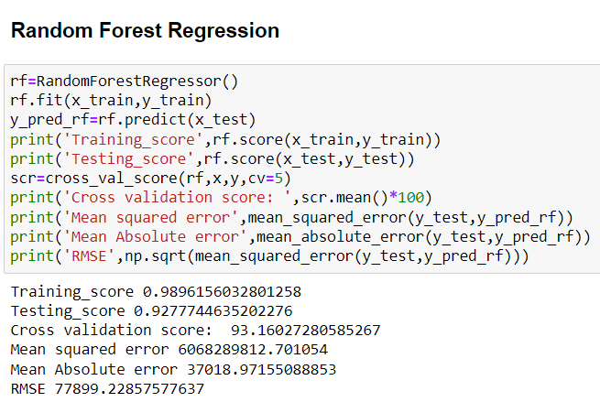
Testing of Identified Approaches (Algorithms)

Slide 11
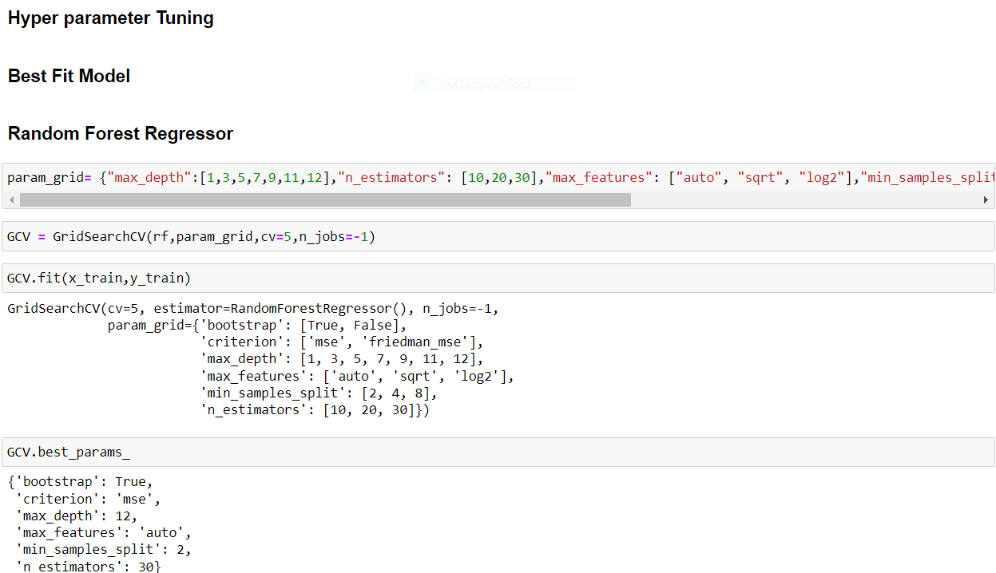
Key Metrics for success in solving problem under consideration
After Checking the model evaluation, I have considered Random Forest Regression as my final model and I have applied hyperparameter tuning to improve the score of the model. By using Grid search cv we are going to pass different parameters for the final algorithm which improves the score of the model and reduction in errors. But after applying grid search cv there is no change in the score and error. So, I have considered old values as for checking the model performance.

Slide 12
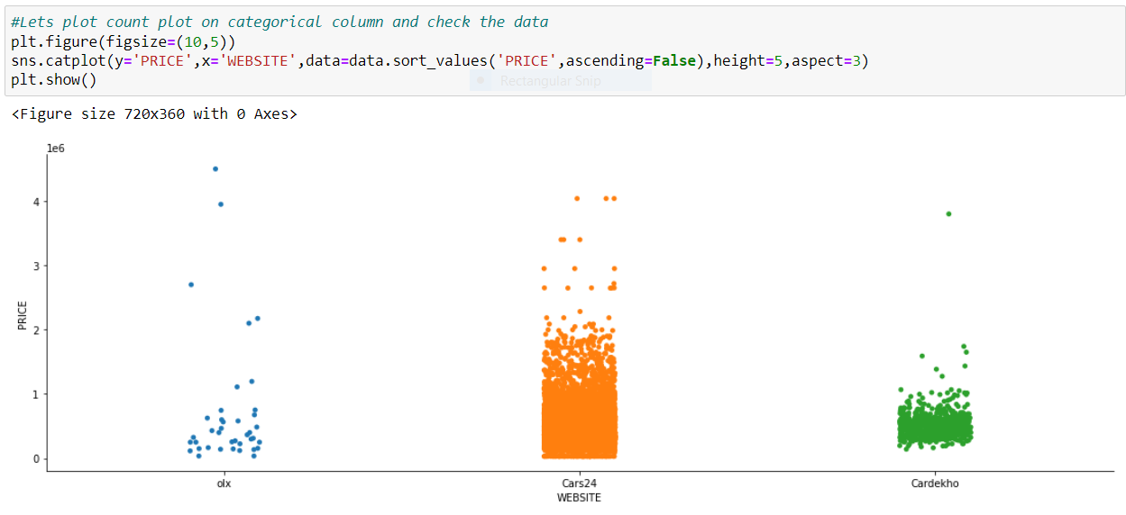
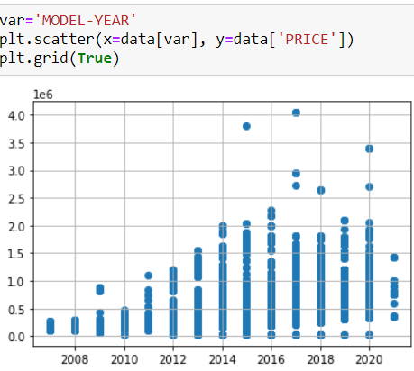
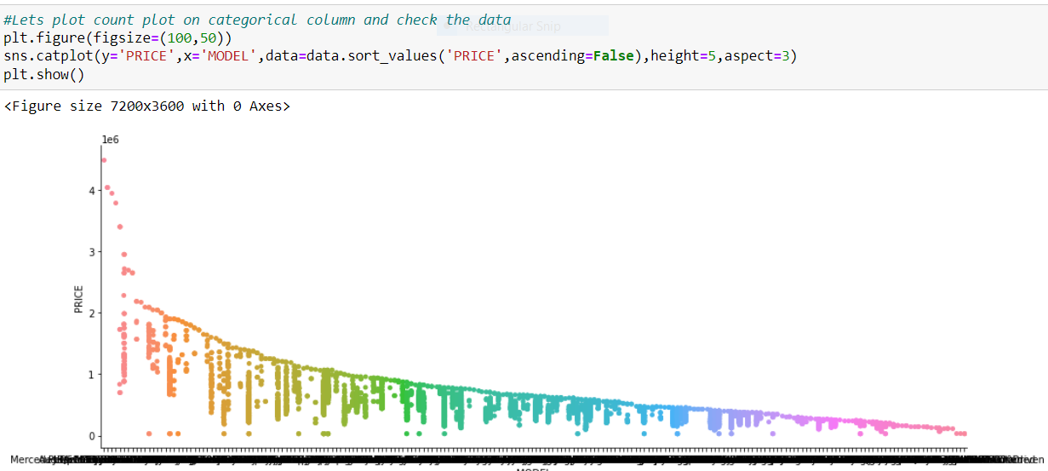
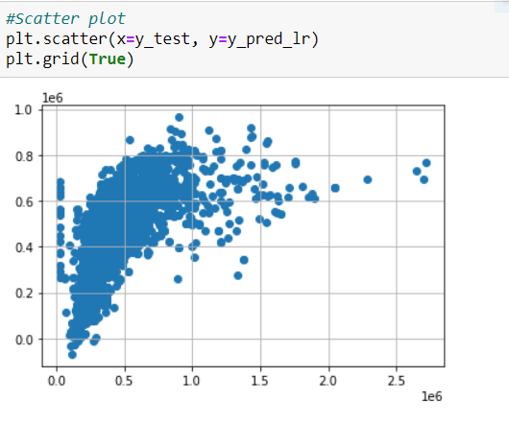
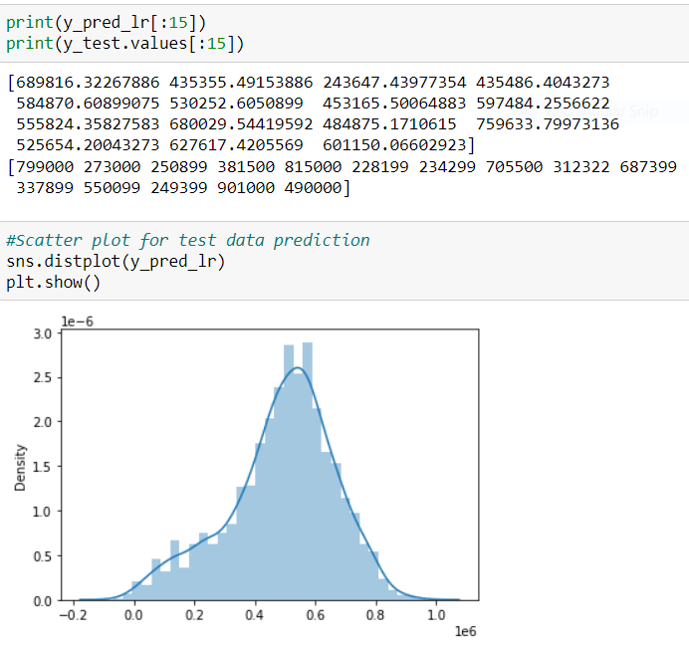
Visualizations

Slide 13
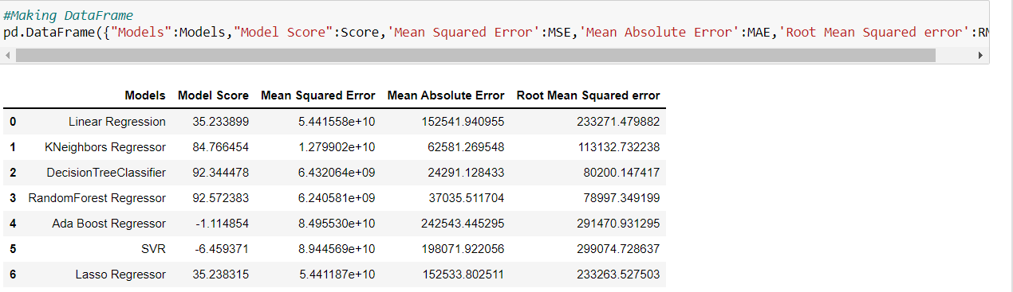
Interpretation of the Results

Slide 14
Conclusions on our model building
We got our best model as Random Forest Regressor with the score of 93% and both the training and testing scores are balanced and the RMSE value is also less compared to all other models. So, we can go further build our model using Random Forest Regressor.

Slide 15
Advantages of pre-owned cars:
Buying a Used Car Saves You Money
Bulk of Depreciation Has Already Occurred
No Exaggerated Fees
Lower Customization Costs
Certified and Thoroughly Inspected
Warranties
Lower Insurance Premiums
Better for the Environment
Lower Annual Registration Fees

Slide 16
Disadvantages of pre-owned cars:
Buying a new problem
Increase repair costs
Not Made to Order
Worse Fuel Efficiency
High Maintenance
Previous Owners
Early-Onset Problems
Old Technology

Slide 17
Conclusions
In the pre-owned car price prediction, I have performed many Regression algorithms to predict the used cars price. The Root Mean squared error (RMSE) errors calculated for all the algorithms are very high. Statistical methods work better, on large set data.
But the length of the dataset is very less so using different methods that match the time-series data will be used in the future research to obtain smaller error prediction values (RMSE) and using more data to get the better result. In future this machine learning model may bind with various website which can provide real time data for price prediction. Also, we may add large historical data of car price which can help to reduce the RMSE error.

